Slide 1
Digital Systems Design & VHDL
Daniel Hart
Notes:
Hi

Slide 2
Agenda
Why is Digital Design important?
What is a Digital signal?
The Building Blocks

Slide 3
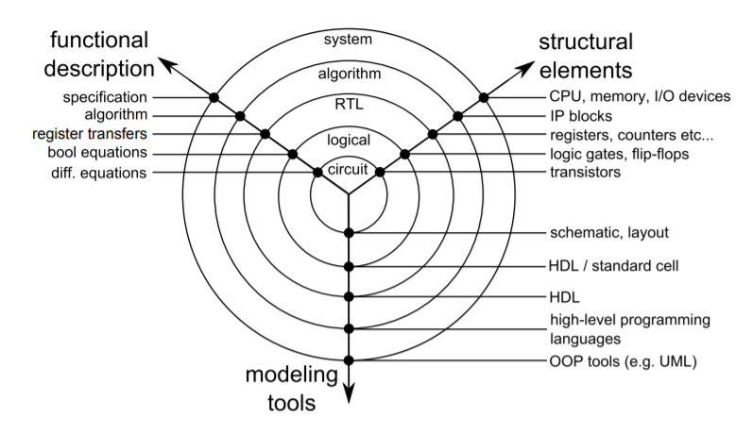
What exactly is Digital System Design

Slide 4
What is a digital signal?
Much like analog, a value that varies over time
Rather than an infinite set of values, it is a discrete (or countable) set (ex. {1,2,3,4})
Binary (also called base 2) is the simplest way to represent a signal
‘1’ or On
‘0’ or Off
Hexadecimal (base 16) is also used
0-9, A-F
Format: 0x[Insert Number here]
Example: 0x17 in hexadecimal is 0001 0111 in binary, which is 23 in decimal

Slide 5
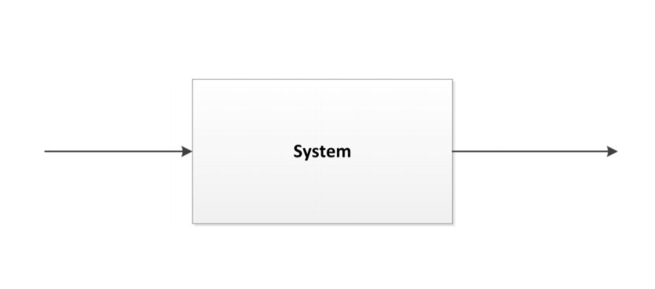
System Model
Engineers are familiar with the following model:
Outside input
Output to outside

Slide 6
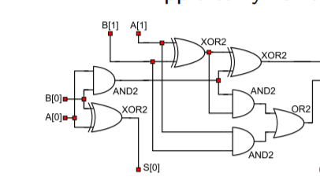




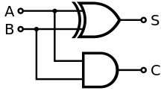
How do we manipulate digital signals
Logic Gates!
Implements a Boolean (logic) function
Take multiple signals, produce one output signal
The fundamental ones are:
NOT
AND
OR
XOR

Slide 7
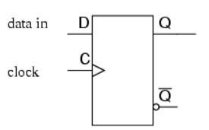
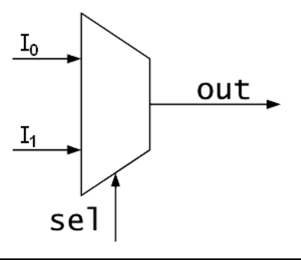
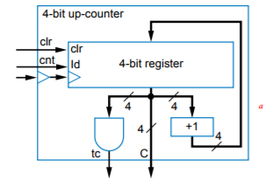
How do we manipulate digital signals
From those building blocks, we make more complex circuits:
Registers
Multiplexers (MUX)
Counters

Slide 8
Hardware Descriptive Languages (HDL)
Two biggest ones: VHDL and Verilog
V in VHDL is VHSIC or Very High Speed Integrated Circuit
Different from programming languages
Operations are performed concurrently rather than sequentially using “process” statements (think of it like multithreading)

Slide 9
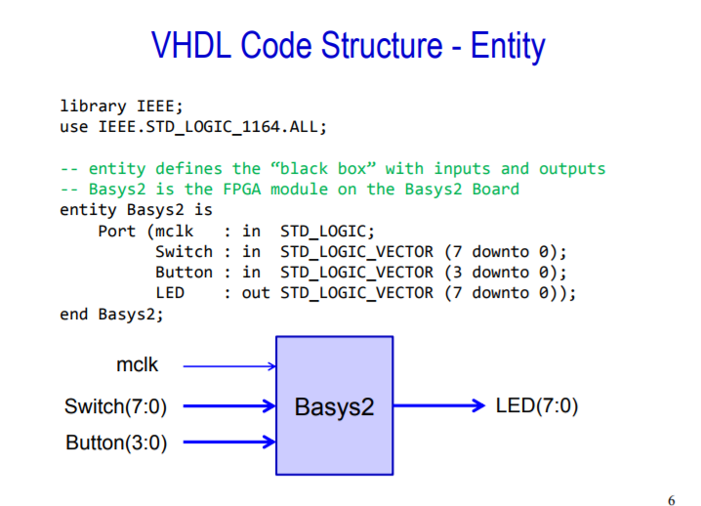
Structure of code: Entity

Slide 10
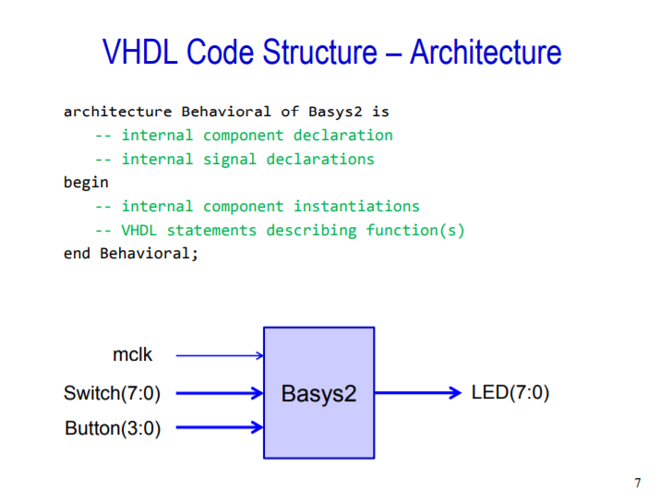
Structure of Code: Architecture

Slide 11
